Slide 1
Contiguous Memory Allocation

Slide 2
Memory Management Techniques
Contiguous Memory Allocation
  Fixed Partitioning
  Variable Partitioning
Non-Contiguous Memory Allocation
  Paging
  Multilevel Paging
  Inverted Paging
  Segmentation
  Segmented Paging

Slide 3
Contiguous Memory allocation
Contiguous memory allocation is one of the efficient ways of allocating main memory to the processes.
  In contiguous memory allocation each process is contained in a single contiguous section of memory.
The memory is divided into two partitions.
  for the Operating System
  for the user processes.
  Operating System is placed in low or high memory depending on the interrupt vector placed.

Slide 4
Contiguous Memory Allocation
Program must exist as a single block of contiguous addresses
There are two methods:
  Fixed-Partition method( Static Partitioning)
    No of partitions are fixed
    Size of each partition may or may not be same.
    Spanning is not allowed
  Variable-Partition Method.
    Initially the whole of the available memory is treated as one large block of memory called a hole.
    From the hole, blocks of main memory are allocated to the programs in the input queue.

Slide 5
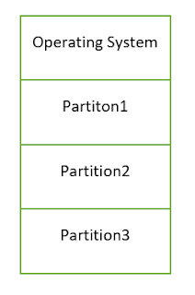
Fixed-Size Partition
4 MB
4 MB
8 MB
4 MB
12 MB
4 MB

Slide 6
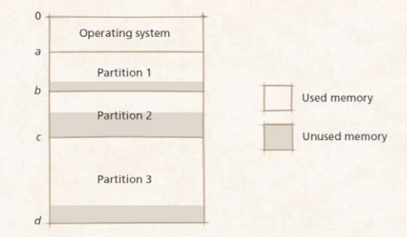
Drawbacks
Drawbacks to fixed partitions
  Internal fragmentation
    Process does not take up entire partition, wasting memory

Slide 7
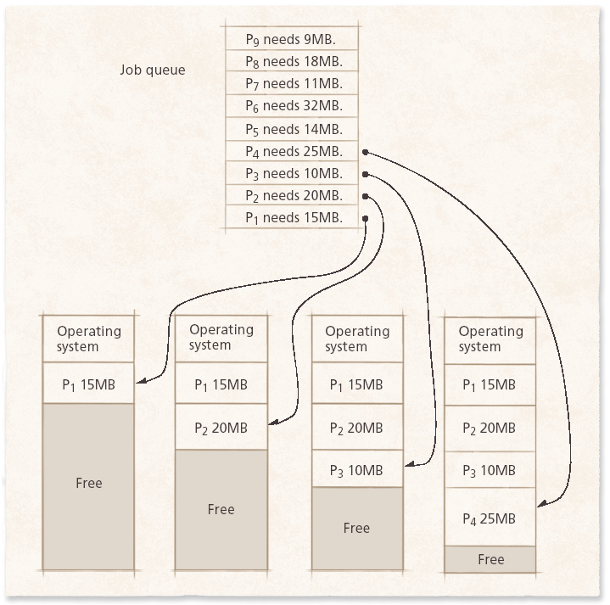
Variable-partition Method

Slide 8
Variable-Partition Method
Jobs placed where they fit
  No space wasted initially
  Degree of multiprogramming increases
  Internal fragmentation impossible
    Partitions are exactly the size they need to be
  External fragmentation can occur when processes removed
    Leave holes too small for new processes
    Eventually no holes large enough for new processes.
    Due to dynamic allocation and deallocation of processes, it can be complex sometimes

Slide 9
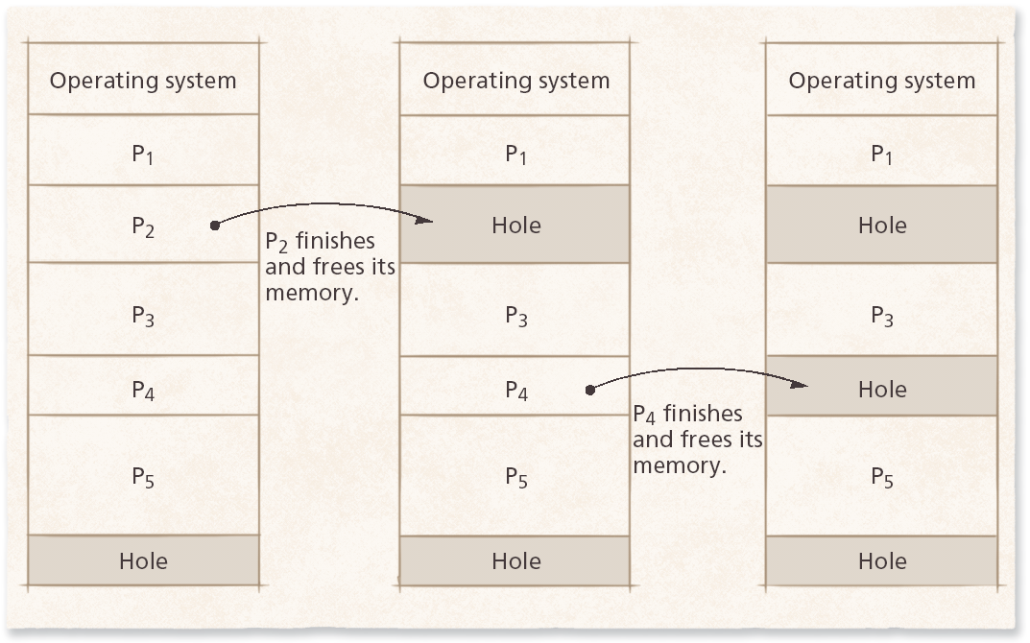

Slide 10
Fragmentation
The disadvantage of contiguous memory allocation is fragmentation.
Internal Fragmentation:
  For example say a hole of size 18464 bytes is available. Let the size of the process be 18462. If the hole is allocated to this process, then two bytes are left which is not used. These two bytes which cannot be used forms the internal fragmentation.
External Fragmentation
  When the total memory space that is got by adding the scattered holes is sufficient to satisfy a request but it is not available contiguously, then this type of fragmentation is called external fragmentation.
  Solution to External Fragmentation is Compaction, Coalescing

Slide 11
  Coalescing
    Combine adjacent free blocks into one large block
    Often not enough to reclaim significant amount of memory
  Compaction
    Sometimes called garbage collection (not to be confused with GC in object-oriented languages)
    Rearranges memory into a single contiguous block free space and a single contiguous block of occupied space
    Makes all free space available
    Significant overhead

Slide 12
Memory Placement Strategies
Where to put incoming processes
  First-fit strategy
    Process placed in first hole of sufficient size found
    Simple, low execution-time overhead
  Best-fit strategy
    Process placed in hole that leaves least unused space around it
    More execution-time overhead
  Worst-fit strategy
    Process placed in hole that leaves most unused space around it
    Leaves another large hole, making it more likely that another process can fit in the hole

Slide 13
Practice Problem
Given five memory partitions of 100Kb, 500Kb, 200Kb, 300Kb, 600Kb (in order), how would the first-fit, best-fit, and worst-fit algorithms place processes of 212 Kb, 417 Kb, 112 Kb, and 426 Kb (in order)? Which algorithm makes the most efficient use of memory?

Slide 14
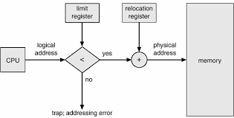
Address Translation(Contiguous memory)

Slide 15
Memory Protection
How do we protect the process from accessing the memory of another process?
By using relocation and limit registers where limit register is the size of the process and relocation register is the starting physical address of the process. Because the memory allocation is contiguous in nature the address of the particular process can be calculated with respect to the base address.
When CPU scheduler selects the process for its execution, the dispatcher loads the values of the registers

Slide 16
Example
Suppose that the value of relocation register is 100040 and limit register is 74600. What are the physical addresses for the following logical addresses?
  70000
  75000
Ans:
1. Check whether logical address < limit register value.
70000<74600. TRUE.
Physical address = logical address + relocation register value
i.e. Physical address = 70000+100040=170040
2. Check whether logical address < limit register value.
75000<74600. FALSE
Trap: addressing error

